Slide 1
Implementing UA
Servers
Randy Armstrong
Software Architect

Slide 2
Overview
Creating the Endpoints
Starting the Server
Creating a Session
Browsing the Address Space
Creating a Subscription
Creating Monitored Items
Reporting Data Changes
Mapping COM DA to UA

Slide 3
Server and the Stack
INodeManager
IDataSource
IEventSource
ICallable
IDataHistorian
IEventHistorian
Application
COM Wrappers
Server Library
UA Stack
IServer
SOAP/HTTP
UA TCP

Slide 4
Server Endpoints
Each server instance has at least one endpoint
Each endpoint has exactly one server instance
Endpoints are implemented by the stack
  UA SDK provides APIs to create and manage endpoints
Endpoints are created when the server starts
Web Client
XML Web Services
http://...
Server
Native Binary
opc.tcp:...
LAN Client

Slide 5
Creating the Endpoints
ServerBase
BaseAddresses
Created automatically when hosted in IIS
ServiceHost
Uses
BindingFactory
Calls
NativeStackBinding
Creates
or
opc.tcp://
Binding
UaTcpBinding
Initializes
XmlSoapBinding
http://
SessionEndpoint
Implements the IDiscoveryEndpoint and ISessionEndpoint contracts

Slide 6
Starting the Server
StandardServer
Non-configurable information from derived class.
Loads
ServerProperties
Information from configuration files.
Loads
ServerConfiguration
Creates
Provides global access to localized resources
ResourceManager
Starts
Starts the NodeManagers which manage the address space
MasterNodeManager
Creates
ServerObject
Contains the ServerDiagnostics
ServerStatus and ServerCapabilities Objects.
DataDictionaries are also loaded
Starts
SessionManager
Starts
SubscriptionManager

Slide 7
Creating a Session
StandardServer
CreateSession
Validate
SessionManager
CertificateValidator
Starts
Creates
Checks the trust chain and server configuration
SessionExpiryTimer
Session
Creates
Stores the SecureChannelId,
UserIdentity and PreferredLocales
SessionDiagnosticsObject
CreateObject
CoreNodeManager
RegisterSource
A NodeSource which registers itself with the CoreNodeManager

Slide 8
Creating Sessions
When a client creates a session the server must
  Validate the client application instance certificate
  Validate the client software certificates
The Session Manager:
  Creates/Monitors/Closes Sessions
  Validates User Identity
The Session:
  Activates
  Impersonates User
  Validates Requests
  Manages Continuation Points

Slide 9
Browsing the Address Space
NamespaceUris
StandardServer
ServerUris
TypeTable
Browse
Determines which NodeManager owns a Node by inspecting the NodeId
All type nodes must be in the TypeTable.
The CoreNodeManager handles browsing of types.
MasterNodeManager
Browse
Browse
NodeManagers
CoreNodeManager
Read
NodeManagers dynamically create nodes by reading the structure of the underlying system
NodeSources delegate Browsing to the CoreNodeManager
NodeSource
Underlying System

Slide 10
Building the Address Space
The responsibility for managing the address space is delegated to one or more NodeManagers.
The CoreNodeManager handles the built-in address space and can be used to expose application data, events and programs.
Additional NodeManagers expose application defined nodes
  Used when the address space cannot be stored in memory
  Used to optimize access to an in memory address space
The MasterNodeManager co-ordinates access to all NodeManagers defined for an application.

Slide 11
Creating a Subscription
StandardServer
CreateSubscription
ValidateRequest
Creates
SubscriptionManager
SessionManager
SessionPublishQueue
Creates
Session
Subscription
Verifies that the Session is still valid and that the SecureChannelId has no changed
Monitors
Periodically checks for Notifications, KeepAlive or Expiry
Creates
CreateObject
SubscriptionDiagnostics
CoreNodeManager
RegisterSource

Slide 12
Managing Subscriptions
The Subscription Manager
  Creates/Deletes Subscriptions
  Manages Publish Queues
  Transfers Subscriptions
The Subscription
  Manages Monitored Items
  Publishes Notifications
  Manages the Message Queue

Slide 13
Creating Monitored Items
StandardServer
Maintains a list of MonitoredItems which must be polled for Notifications to Report
CreateMonitoredItems
SubscriptionManager
Subscriptions for Events are handled by the EventManager
Subscription
MasterNodeManager
NodeManager
EventManager
Subscriptions for DataValues are handled by the NodeManager that owns the Node
Creates
MonitoredItem

Slide 14
Reporting Data Changes
The NodeManager must create a SamplingGroup for polled values. The SamplingGroup periodically reads the value and updates the MonitoredItem
SamplingGroupManager
Read
SamplingGroup
NodeManager
Read
MonitoredItem
Underlying System
Exception based systems will update the MonitoredItem directly

Slide 15
Reporting Events
MasterNodeManager
The NodeManager keeps track of the Objects which are subscribed to. Each event raised must include a list of MonitoredItems which are affected.
SubscribeToEvents
A thread pulls events off the Queue updates the affected MonitoredItems
NodeManager
CreateMonitoredItems
Queue
EventManager
Underlying System
Creates a subtype of BaseEvent and adds it to the event queue
MonitoredItem
Applies the EventFilter when an Event is received.

Slide 16
Mapping COM DA to UA
Branches
  No DataType → FolderType Objects
  DataType → DataItem Variables
  HasComponent reference to Parent
Items
  EUHigh and EULow → AnalogItem Variables
  EUInfo → MultiStateDiscrete Variables
  OpenLabel and CloseLabel → TwoStateDiscrete Variables
  HasComponent reference to Parent
Properties
  AccessRights → AccessLevel Attribute
  DataType → DataType and ArraySize Attribute

Slide 17
Mapping COM DA to UA (2)
Properties
  DataType → DataType and ArraySize Attribute
  AccessRights → AccessLevel Attribute
  ScanRate → MinimumSamplingInterval Attribute
  EUHigh and EULow → EURange Property
  EUInfo → EnumStrings Property
  TimeZone → TimeZone Property
  IRHigh and IRLow → InstrumentRange Property
  Description → Description Attribute
  EngineeringUnits → EUInformation Property
  OpenLabel → FalseLabel
  CloseLabel → TrueLabel
  All Others → Property Variable
  HasProperty reference to Parent

Slide 18
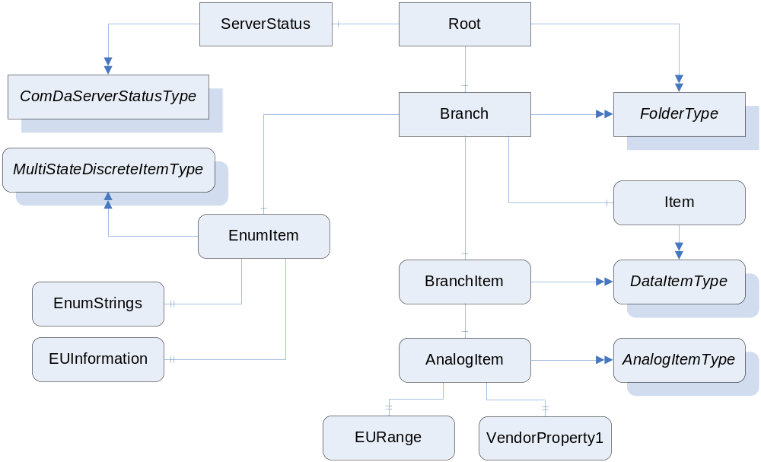
Mapping COM-DA to UA

Slide 19
Mapping COM-AE to UA
Areas are modeled as Objects with type ‘AreaType’
Event Types and Categories are modeled as subtypes of the ‘BaseEventType’ ObjectType
Conditions and SubConditions are modeled with the ‘StateMachineDefinitionType’ ObjectType
Sources are modeled as Objects with the EventNotifier attribute
Relationships between Areas and Sources use the ‘HasNotifier’ ReferenceType
Event Attributes are modeled as Properties of ObjectTypes

Slide 20
Mapping COM-HDA to UA
Aggregates are modeled as Objects
Items are modeled as Variables with the HistoryRead or HistoryWrite flags in AccessLevel attribute set to true
Branches are modeled as Objects with type ‘FolderType’
Relationships between Branches and Items use the ‘Organizes’ ReferenceType

Slide 21
Summary
UA Servers can expose all aspects of real systems in a cohesive, integrated address space.
UA reference implementation will include a set of general server classes that can be used to develop any type of UA server application.
The OPC Foundation is building COM wrapper that will allow existing COM servers to expose their information via UA.

Slide 22


Questions?
Randy Armstrong
Software Architect, OPC Foundation
randy.armstrong@opcfoundation.org

